Slide 1
Page Layout
By Jinzhu Gao

Slide 2
Learning Objectives
Learn how to customize the layout of web pages
CSS box model: a set of CSS rules and properties
“floating” elements: positioned at the left or right edge of a page
absolute and fixed positioning
alignment

Slide 3
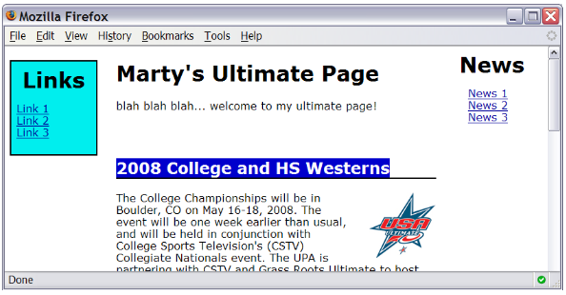
Motivation
want to be able to style individual elements, groups of elements, sections of text or of the page
To create complex page layouts

Slide 4
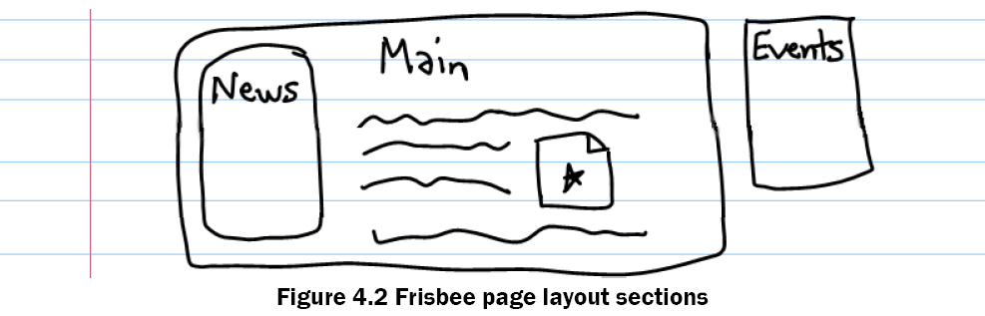
What to do
Draw out a rough sketch of the sections of a page
Learn new HTML tags to represent sections of a page
Write more precise CSS selectors for styling

Slide 5
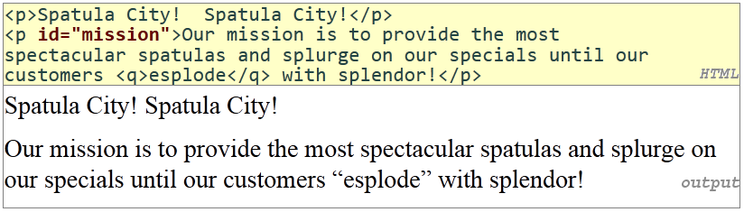
The HTML id Attribute
Allows you to give a unique ID to any element on a page
Each ID must be unique; can only be used once in the page

Slide 6
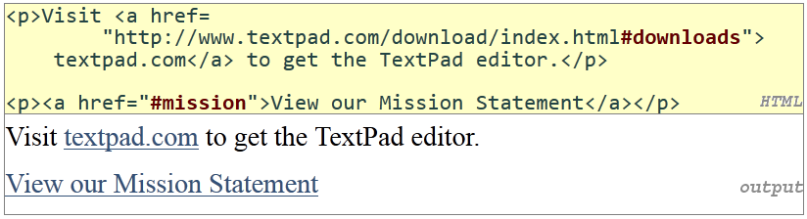
Linking to sections of a web page
A link target can include an ID at the end, preceded by a #
Browser will load that page and scroll to element with given ID

Slide 7
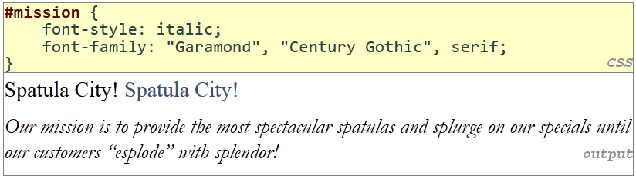
CSS ID Selectors
Applies style only to the paragraph that has the ID of mission
Element can be specified explicitly: p#mission {

Slide 8
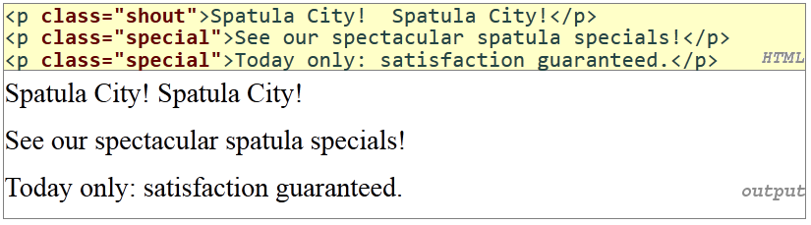
The HTML class Attribute
classes are a way to group some elements and give a style to only that group
Unlike an id, a class can be reused as much as you like on the page

Slide 9
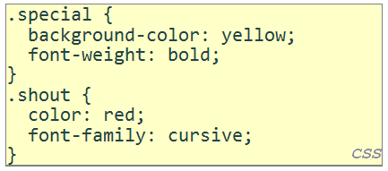
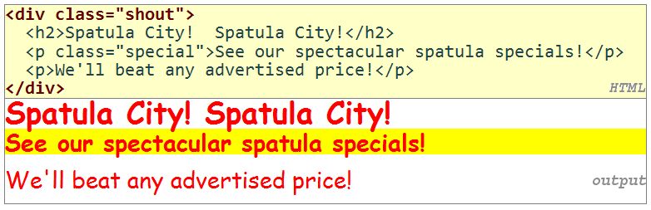
Styling Page Sections
Page Sections (div)
Element | div
Description | Section of a page (block)
Syntax | <div> content </div>

Slide 10
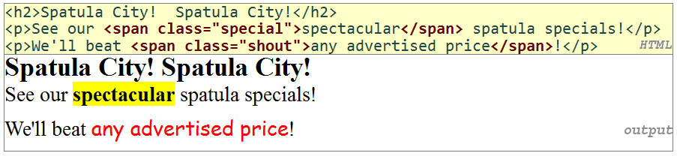
Styling Page Sections
Spans of Text (span)
Element | span
Description | Short section of content (inline)
Syntax | <span>content</span>

Slide 11
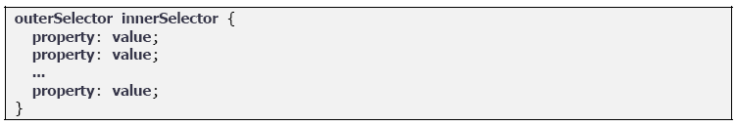
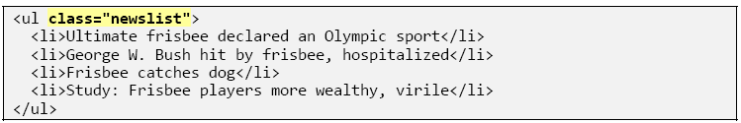
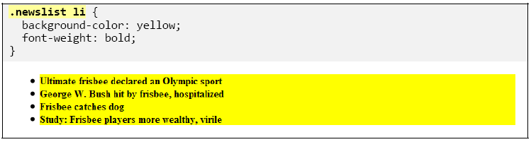
CSS Context Selectors
A CSS rule that applies only to elements that reside inside another particular element.

Slide 12
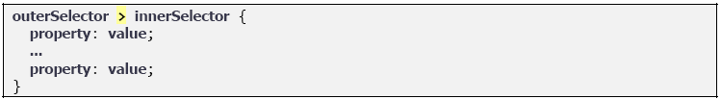
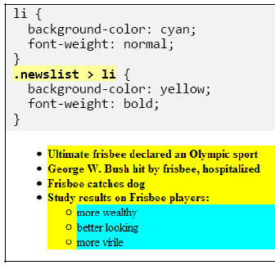
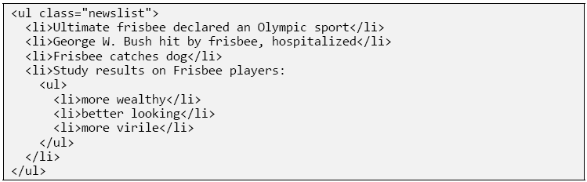
Direct Context Selector
The style will be applied only to inner elements that reside directly inside the outer element

Slide 13
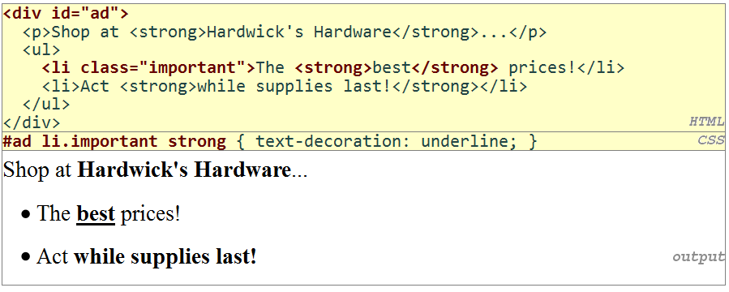
Context Selector Using Wildcard
If you have a div with an id of banner, and you want to give every element inside that div a block border, but not give the div itself such a border

Slide 14
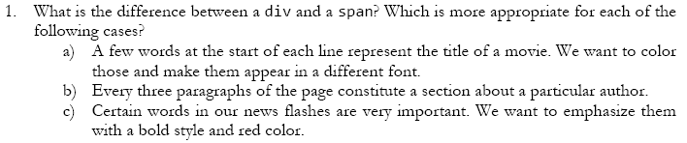
Self-Check
Notes:
1 a) span b) div c) span
2. a)

Slide 15
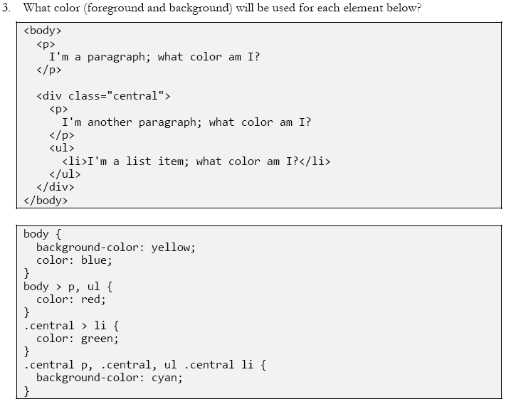
Self-Check

Slide 16
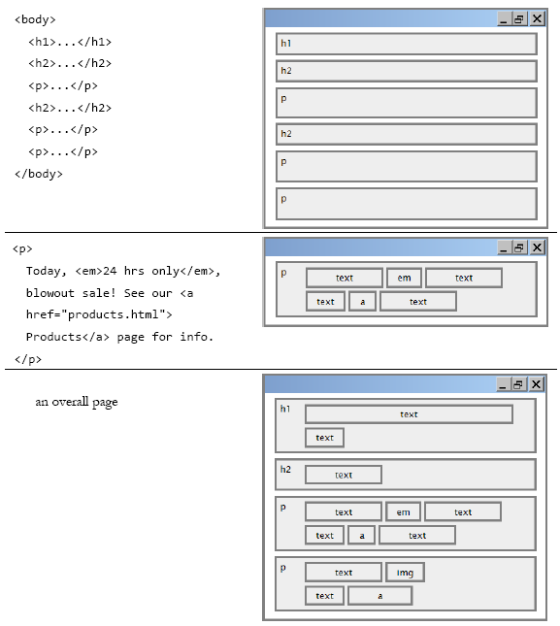
Layout

Slide 17
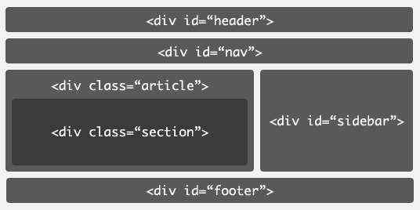
Page Layout in Classic HTML
Web pages often have to give semantic meaning to content through class and id attributes, rather than through the tag elements themselves

Slide 18
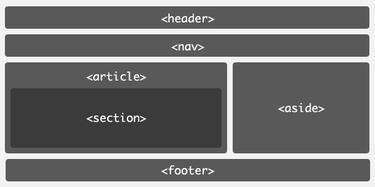
Page Layout in HTML 5

Slide 19
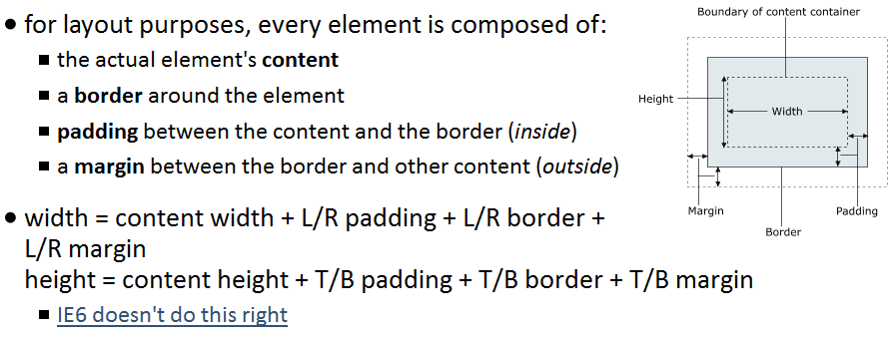
CSS Box Model
The set of rules that governs the size, shape, spacing, borders, and margins of page element

Slide 20
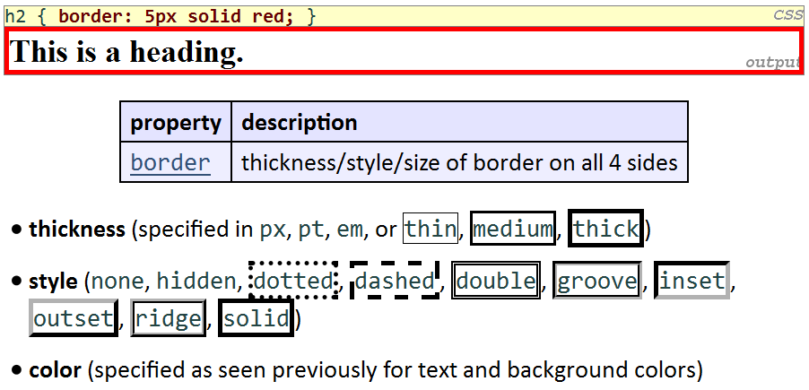
Borders

Slide 21
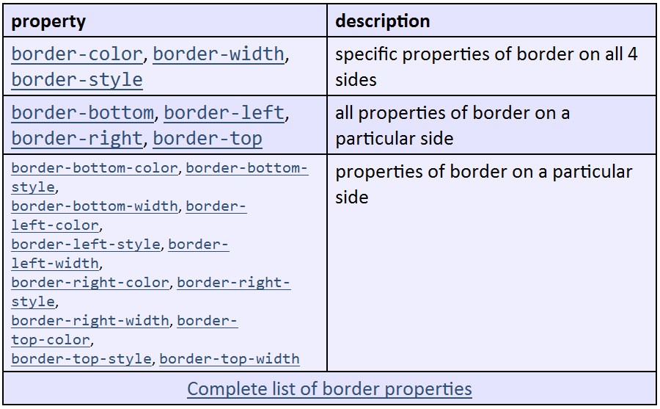
Borders

Slide 22
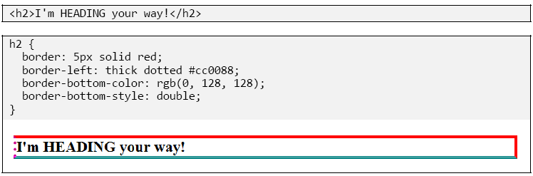
Borders
Notes:
if you omit some properties, they receive default values (e.g. border-bottom-width above)

Slide 23
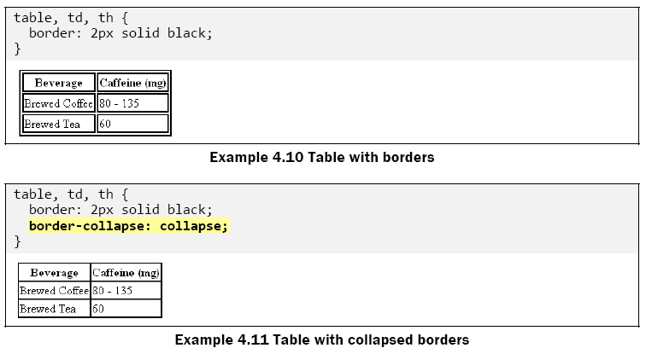
Borders

Slide 24
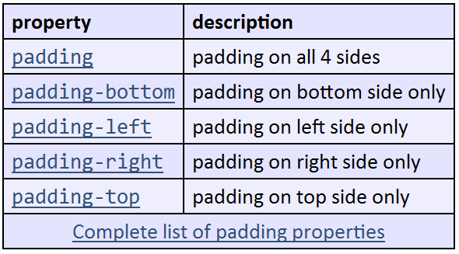
Padding

Slide 25
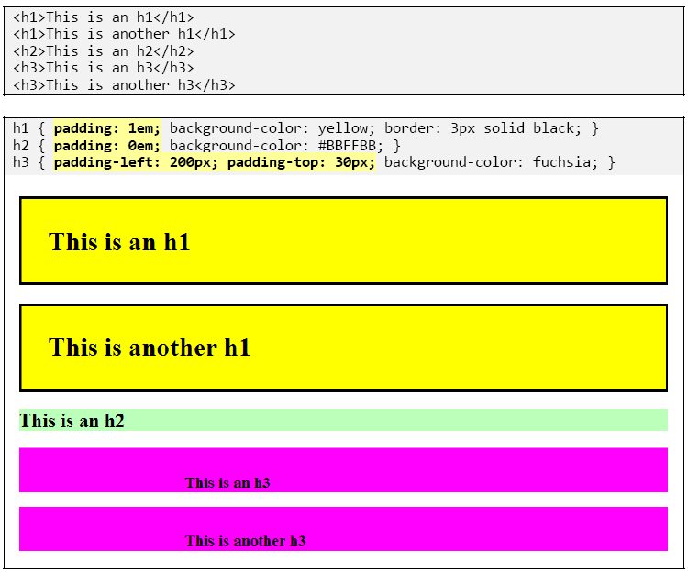
Padding

Slide 26
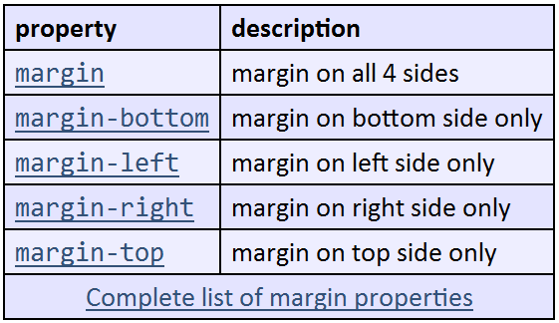
Margins

Slide 27
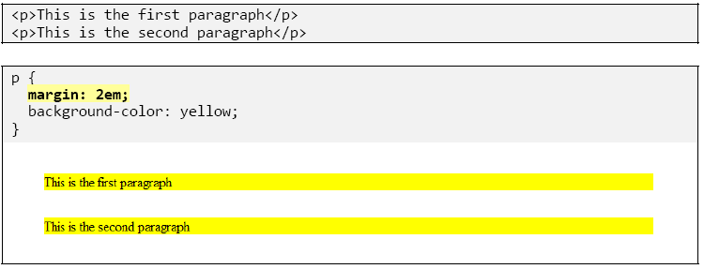
Margins

Slide 28
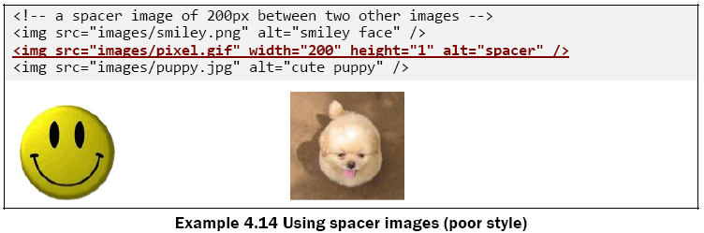
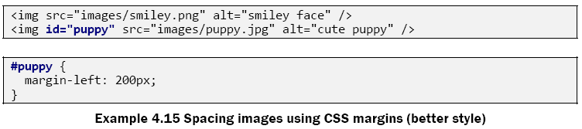
Margins

Slide 29
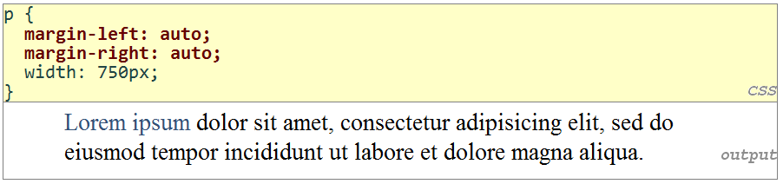
Auto Margins: Centering a block element

Slide 30
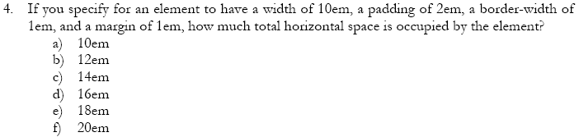
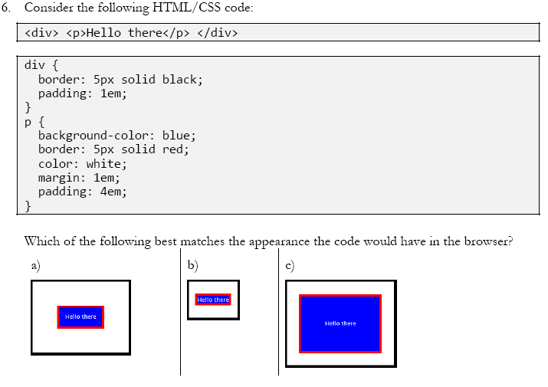
Self-Check
Notes:
4. e)
6. c)

Slide 31
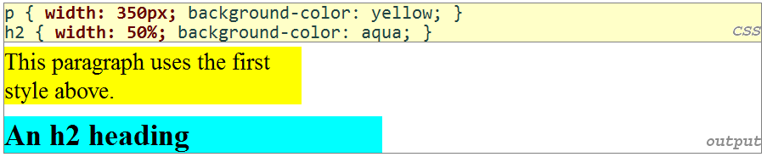
Sizing
Property | Meaning
width, height | How wide or tall to make the element’s content area
max-width, max-height, min-width, min-height | The minimum or maximum size of this element

Slide 32
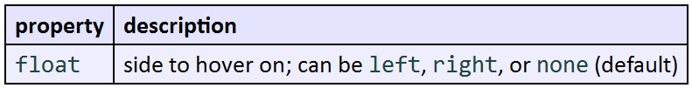
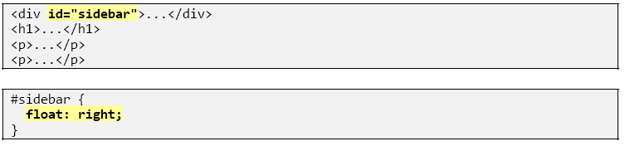
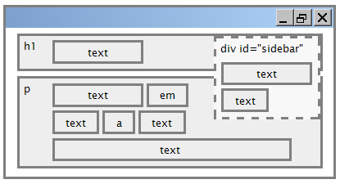
Floating Elements
Notes:
If you simply want something on the left or right side of the page, align it. If you want it to hover on that side of the page with other content wrapping around it, float it.

Slide 33
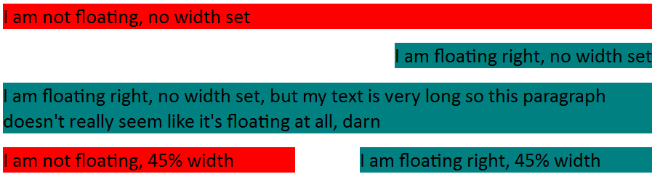
Floating Elements with Widths
Notes:
If you simply want something on the left or right side of the page, align it. If you want it to hover on that side of the page with other content wrapping around it, float it.

Slide 34
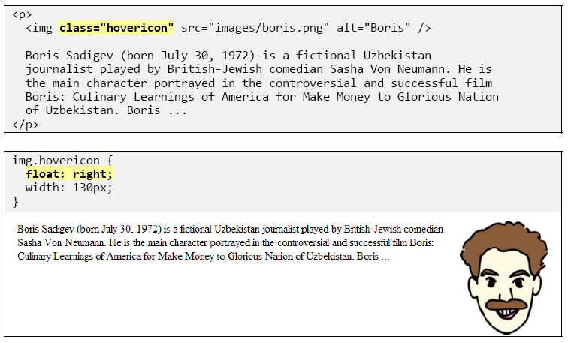
Floating Image
Notes:
If you simply want something on the left or right side of the page, align it. If you want it to hover on that side of the page with other content wrapping around it, float it.

Slide 35
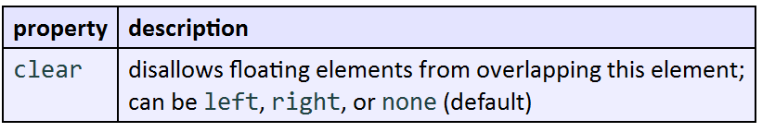
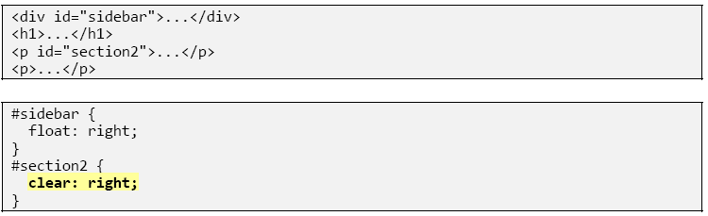
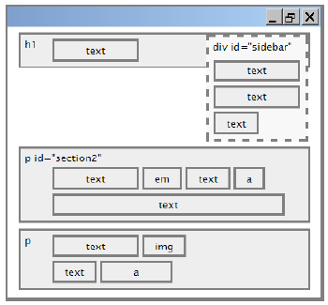
The clear Property

Slide 36
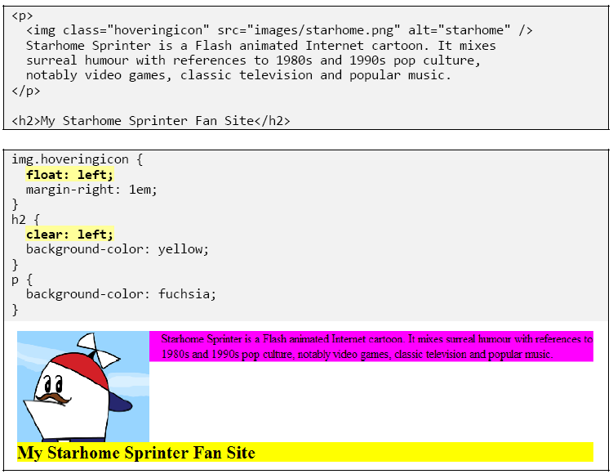
The clear Property

Slide 37
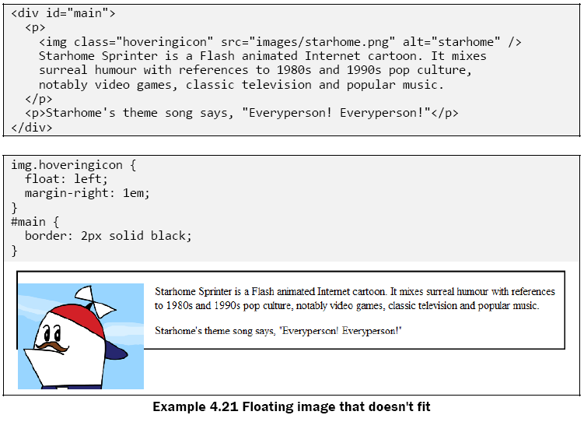
Making Floating Elements Fit

Slide 38
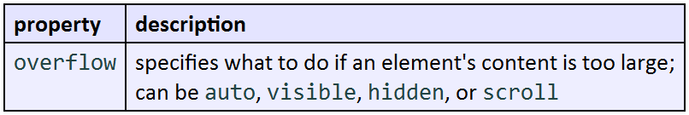
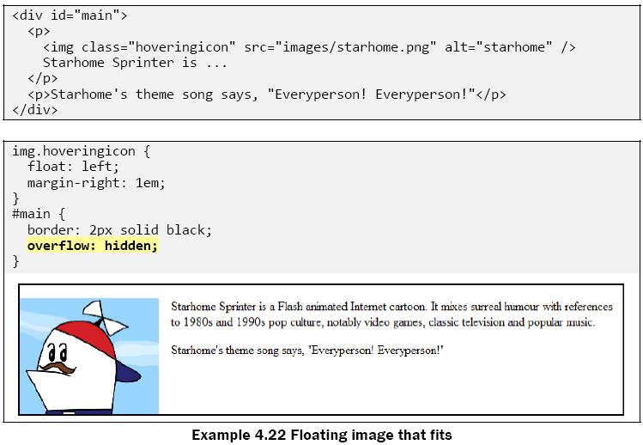
Making Floating Elements Fit
Notes:
Hidden/auto: the browser will make the element large enough to fit the floating content

Slide 39
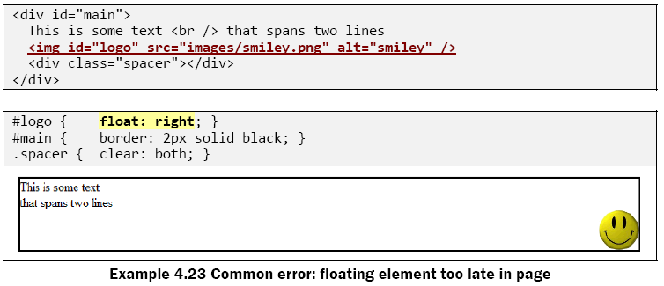
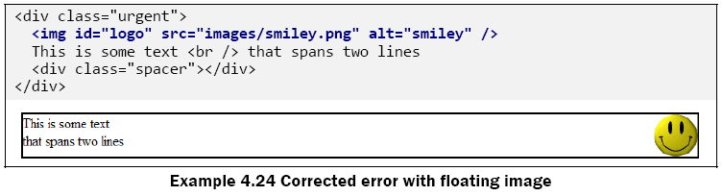
Common Error

Slide 40

Multi-Column Floating Layouts

Slide 41

Self-Check

Slide 42


Positioning

Slide 43


Absolute Positioning
Notes:
They are positioned at an offset relative to the block element containing them, assuming that block also uses absolute or relative positioning. (If it doesn't, the position is relative to the edges of the overall web page.)

Slide 44

Relative Positioning
Notes:
absolute-positioned elements are normally positioned at an offset from the corner of the overall web page
to instead cause the absolute element to position itself relative to some other element's corner, wrap the absolute element in an element whose position is relative

Slide 45


Absolute Positioning with relative containing element

Slide 46


Fixed Positioning

Slide 47


Fixed Positioning

Slide 48

Vertical Alignment

Slide 49



Vertical Alignment

Slide 50


Vertical Alignment: Common Error
Notes:
Because the image is vertically aligned to the baseline of the paragraph, which is not the same as the bottom

Slide 51

Alignment vs. float vs. position

Slide 52





Element Visibility

Slide 53

Self-Check

Slide 54
Summary
CSS box model
“floating” elements
absolute and fixed positioning
Alignment

